Slide 1
Clustering algorithms and cluster analysis

Slide 2
Similarity measure
is a numerical measure of how alike two data objects are.
higher when objects are more alike.
often falls in the range [0,1]
Similarity might be used to identify
duplicate data that may have differences due to typos.
equivalent instances from different data sets. E.g. names and/or
addresses that are the same but have misspellings.
groups of data that are very close (clusters)
Dissimilarity measure
is a numerical measure of how different two data objects are
lower when objects are more alike
minimum dissimilarity is often 0 while the upper limit varies depending on how much
variation can be
Dissimilarity might be used to identify
outliers
interesting exceptions, e.g. credit card fraud
boundaries to clusters
Proximity refers to either a similarity or dissimilarity

Slide 3
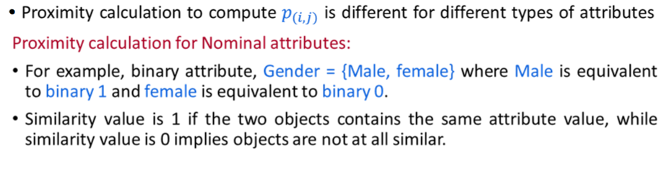

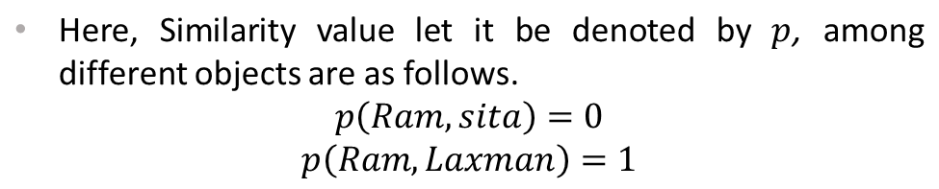
Proximity Calculation
Object | Gender
Ram | Male
Sita | Female
Laxman | Male

Slide 4
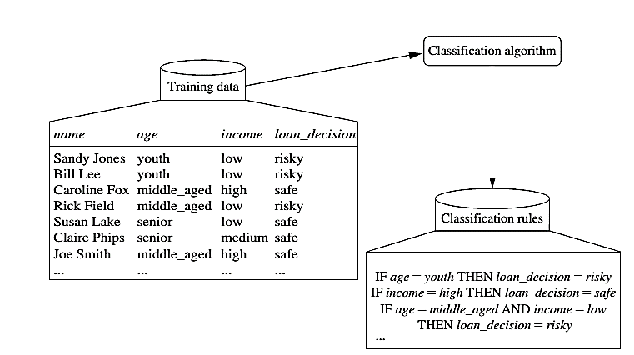
Classification Steps:
Learning

Slide 5
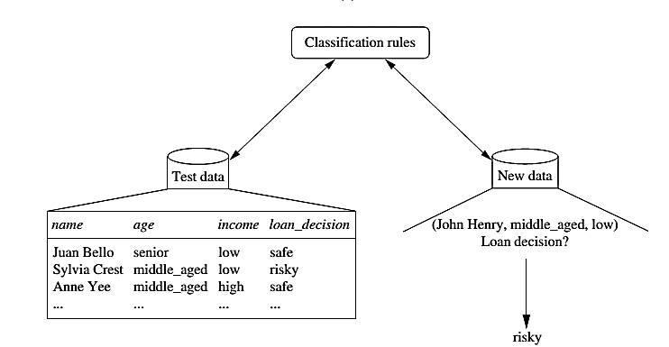
Classification

Slide 6



Process (1): Model Construction
Classification
Algorithms
Training
Data
Classifier
(Model)
IF rank = ‘professor’
OR years > 6
THEN tenured = ‘yes’

Slide 7


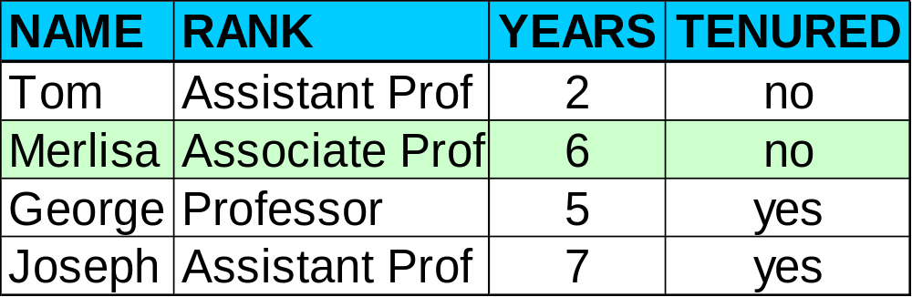

Process (2): Using the Model in Prediction
Classifier
Testing
Data
Unseen Data
(Jeff, Professor, 4)
Tenured?

Slide 8
Supervised vs. Unsupervised Learning
Supervised learning (classification)
  Supervision: The training data (observations, measurements, etc.) are accompanied by labels indicating the class of the observations
  New data is classified based on the training set
Unsupervised learning (clustering)
  The class labels of training data is unknown
  In this we can predict the class labels by using clustering technique.

Slide 9
K –MEANS ALGORITHM
Simplest unsupervised learning algorithms
It is an iterative algorithm that divides the unlabeled dataset into k different clusters in such a way that each dataset belongs only one group that has similar properties.
Easy way to classify a given data set through number of cluster observations into groups of related observations
Complexity is O( n * K * I * d )
n = number of points, K = number of clusters,
I = number of iterations, d = number of attributes
Medical imaging, biometrics and related fields
Note: Big O means O(N) i.e “How does the number of steps change as the input data elements increase?”

Slide 10
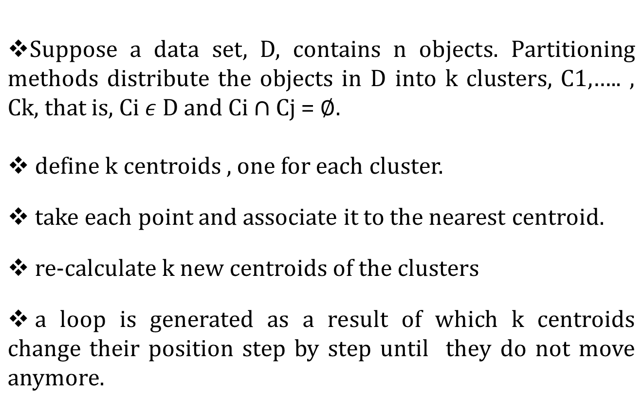
HOW IT WORKS ????

Slide 11



Finally this algorithm aims at minimizing an objective function
or
Where is choosen distance measure between data point
and the cluster centre is an indicator of the distance of n
data points from respective cluster centres.

Slide 12
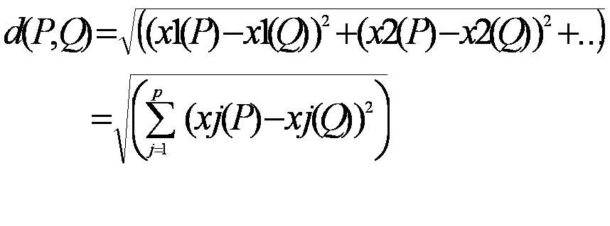
Let m_{i} be the mean of the vectors in cluster i
m_{i} is calculated randomly by using
    Euclidian metric: The commonly used distance measure is the Euclidean metric (mostly in case of multi-dimensional data)which defines the distance between two points
    P= ( x1(P), x2(P),…) and Q = ( x1(Q),x2(Q),…) is given by:

Slide 13
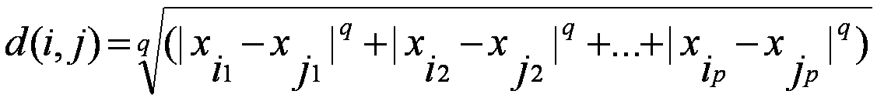

    Minskowski distance:
      where i = (x_{i1}, x_{i2}, …, x_{ip}) and j = (x_{j1}, x_{j2}, …, x_{jp}) are two p-dimensional data objects, and q is a positive integer
    Manhattan distance:
      If q = 1 , d gives the Manhattan distance

Slide 14
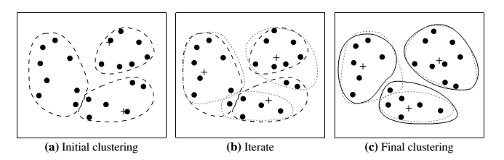
Example

Slide 15
K-means Clustering – Example 1:
A pizza chain wants to open its delivery centers across a city. What do you think would be the possible challenges?
They need to analyze the areas from where the pizza is being ordered frequently.
They need to understand as to how many pizza stores has to be opened to cover delivery in the area.
They need to figure out the locations for the pizza stores within all these areas in order to keep the distance between the store and delivery points minimum.
Resolving these challenges includes a lot of analysis and mathematics. We would now learn about how clustering can provide a meaningful and easy method of sorting out such real life challenges. Before that let’s see what clustering is.

Slide 16
K-means Clustering Method:
If k is given, the K-means algorithm can be executed in the following steps:
Partition of objects into k non-empty subsets
Identifying the cluster centroids (mean point) of the current partition.
Assigning each point to a specific cluster
Compute the distances from each point and allot points to the cluster where the distance from the centroid is minimum.
After re-allotting the points, find the centroid of the new cluster formed.

Slide 17

K--MEDOID CLUSTERING
K-Medoids (also called Partitioning Around Medoid) algorithm was proposed in 1987 by Kaufman and Rousseeuw. A medoid can be defined as a point in the cluster, whose dissimilarities with all the other points in the cluster are minimum. The dissimilarity of the medoid(Ci) and object(Pi) is calculated by using E = |Pi – Ci|
The cost in K-Medoids algorithm is given as

Slide 18
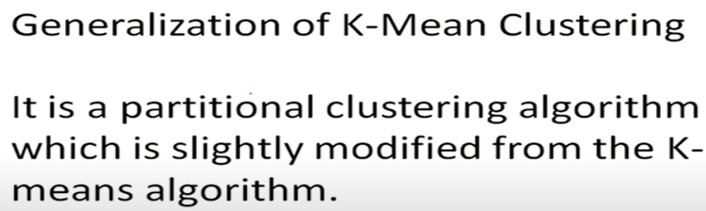
K--MEDOID CLUSTERING
The k-means algorithm is sensitive to outliers because such objects are far away from the majority of the data, and thus, when assigned to a cluster, they can dramatically distort the mean value of the cluster.

Slide 19
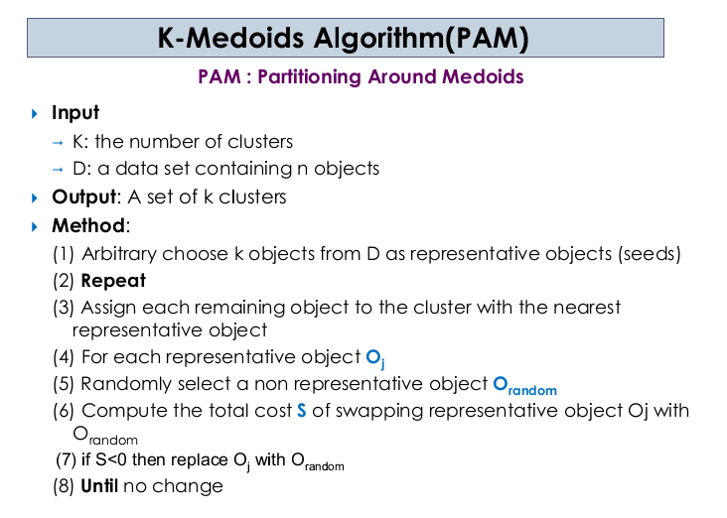

Slide 20
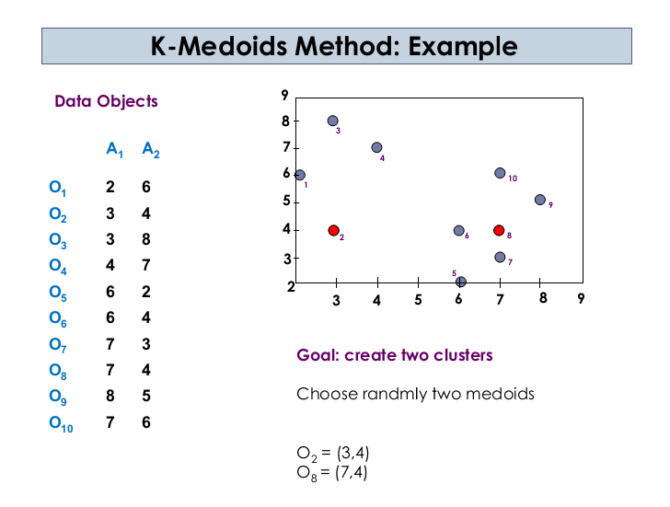

Slide 21
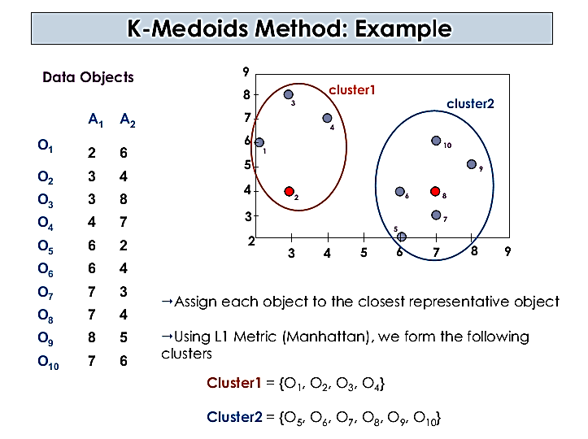

Slide 22
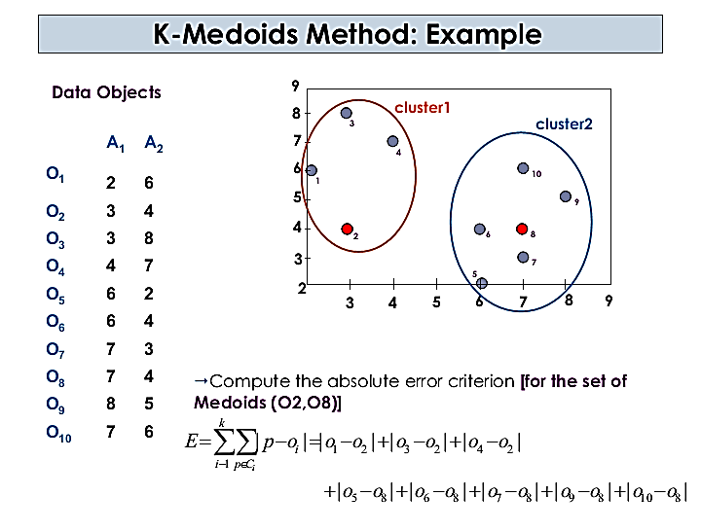

Slide 23
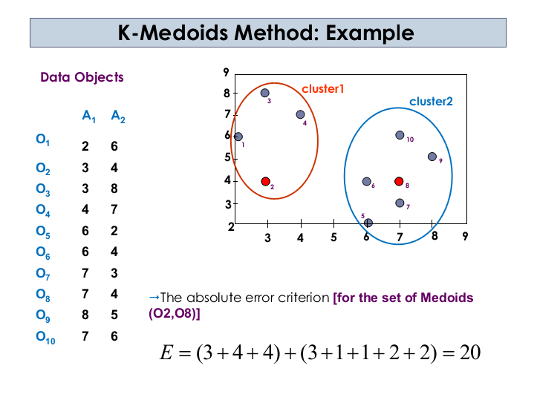

Slide 24
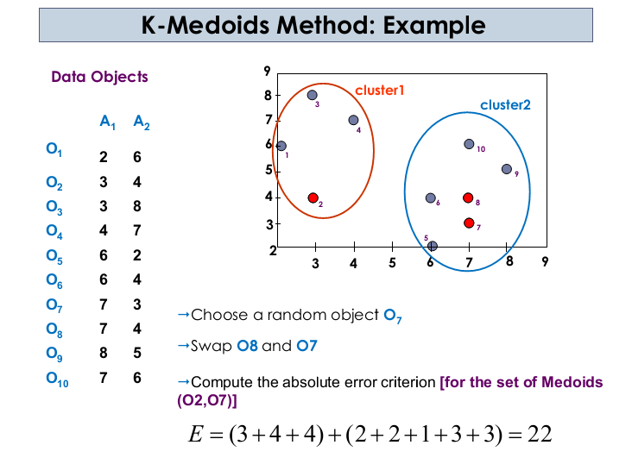

Slide 25
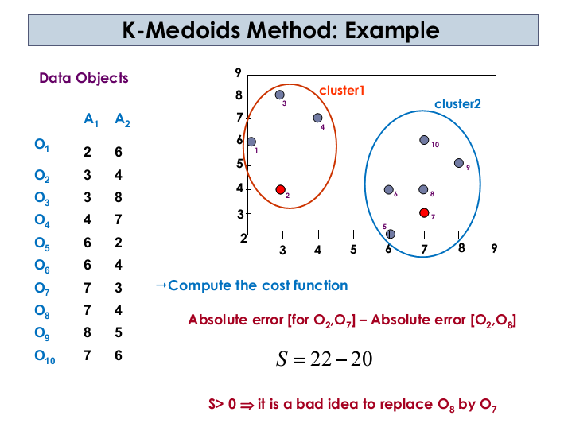

Slide 26
“Which method is more robust—k-means or k-medoids?”
The k-medoids method is more robust than k-means.
Because in the presence of noise and outliers medoid is less influenced by outliers or other extreme values than a mean.

Slide 27
Hierarchical Clustering
Use distance matrix as clustering criteria. This method does not require the number of clusters k as an input, but needs a termination condition
Step 0
Step 1
Step 2
Step 3
Step 4
agglomerative
(AGNES)
a
a b
b
a b c d e
c
c d e
d
d e
e
divisive
(DIANA)
Step 4
Step 3
Step 2
Step 1
Step 0

Slide 28
Hierarchical Clustering
Clusters are created in levels actually creating sets of clusters at each level.
Agglomerative
  Initially each item in its own cluster
  Iteratively clusters are merged together
  Bottom Up
Divisive
  Initially all items in one cluster
  Large clusters are successively divided
  Top Down

Slide 29
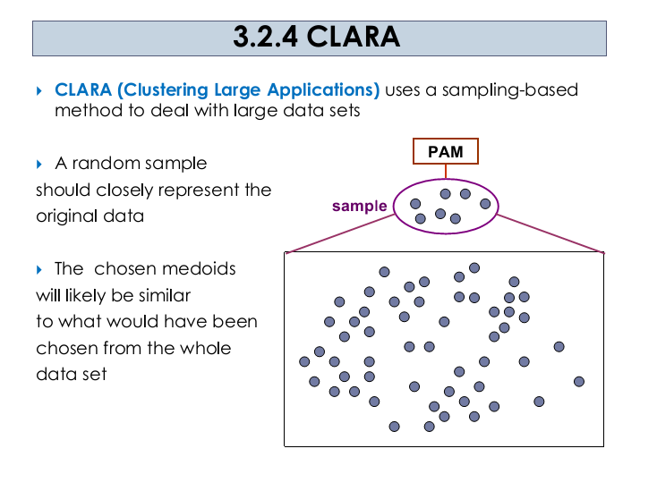

Slide 30
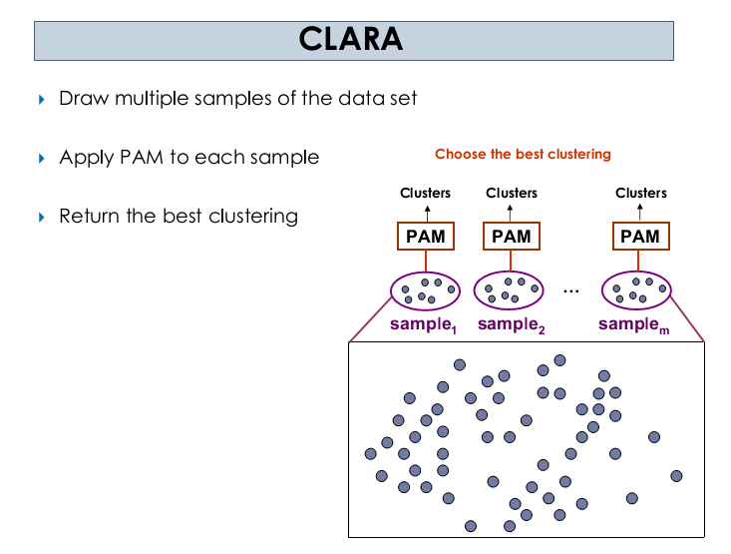
In many cases, a large sample works well if it is created so that each object has equal probability of being selected into the sample.

Slide 31
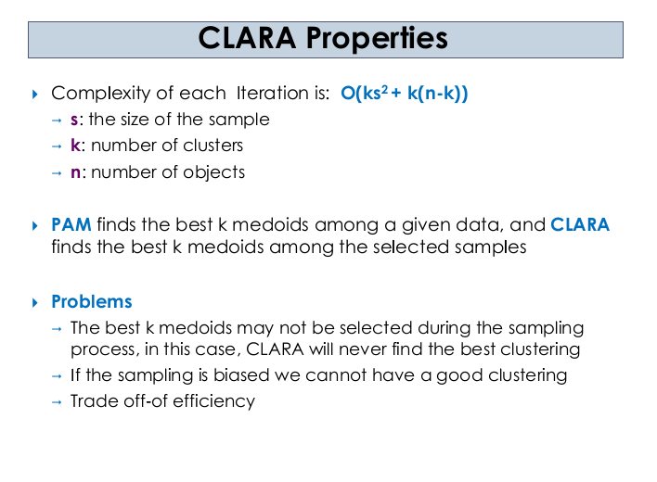

Slide 32
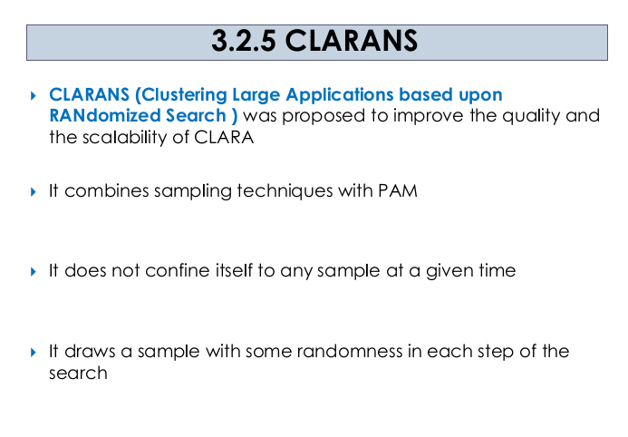

Slide 33
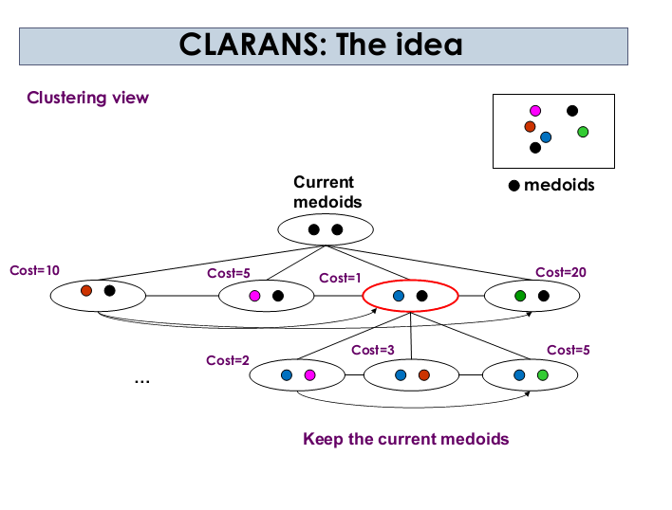

Slide 34
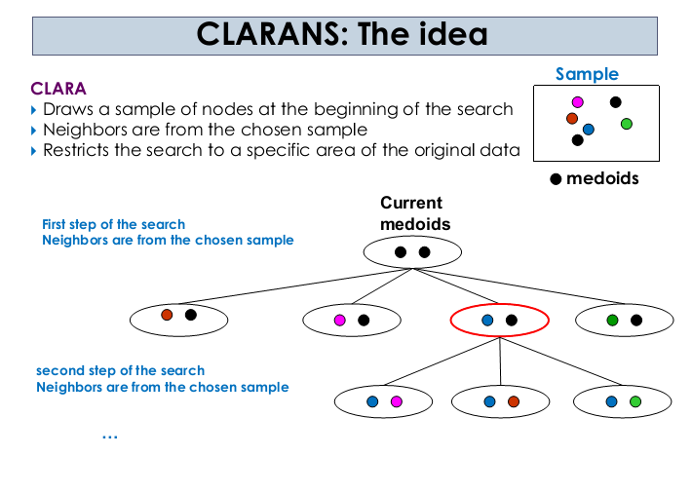

Slide 35
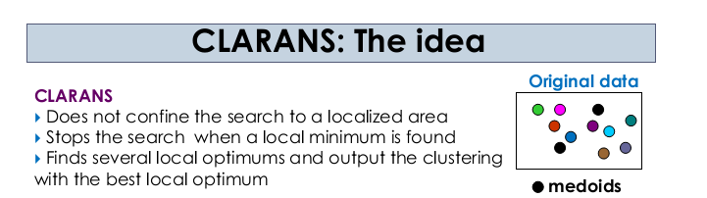

Slide 36
